Slide 1
COMPUTER GRAPHICS
ANIMATION

Slide 2
‘Animating’ a thing
means to impart movement to something which can’t move on its own.
to specify, either directly or indirectly, how the ‘thing’ is to move through time and space
Traditionally, artist creates a succession of cartoon frames, which are then combined into a film.

Slide 3
The Power of Animation
Animation grabs attention
Transitions are simple forms of animation
Wipe
Zoom
Dissolve

Slide 4

Principles of animation
How Animation Works
Persistence of vision
Still images are flashed in sequence
Frame rate measures the speed of change

Slide 5
Principles of Animation
Persistence of Vision -biological phenomenon - an object seen by the human eye remains mapped on the retina for a brief time after viewing.
Causes the visual illusion of movement, when images change slightly and rapidly
Even after the object is removed, the impression of an object seen by the eye remains on the retina for 1/16th of a second.
If we see another object before this time, the impressions of the two merge to give us a sense of continuity.

Slide 6
Principles of Animation
Television video creates 30 frames per second
Movies are shot at a rate of 24 frames per second and replayed at 48 frames per second
Both are used to create motion and animation

Slide 7
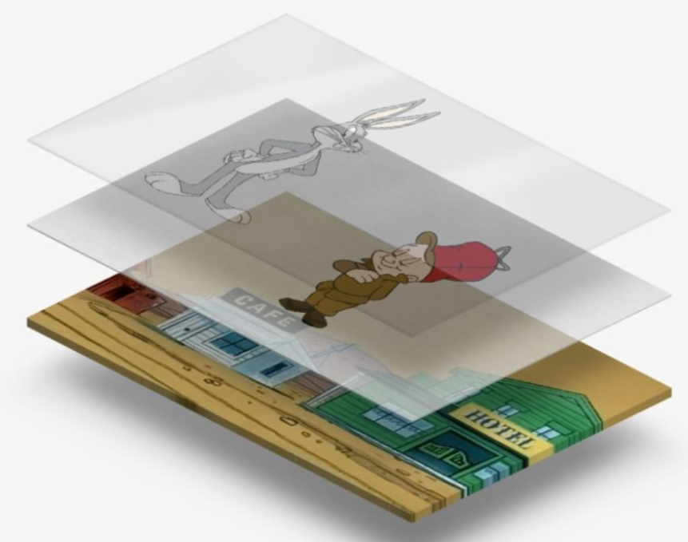
Principles of Animation
Cel Animation
Keyframes identify the start and end of action
major frames of the animation
The process of filling in the action is called tweening

Slide 8
Animation Techniques
Cel Animation
The technique made famous by Disney
Progressively different graphics on each frame of movie film
Clear celluloid sheets were used to draw each frame
( 24 frames/sec. * 60 sec/min) = 1440 separate frames needed to produce one minute of a movie
https://www.youtube.com/watch?v=ElXRkfVBIp0
https://www.youtube.com/watch?v=Ab9GV1elg1A

Slide 9
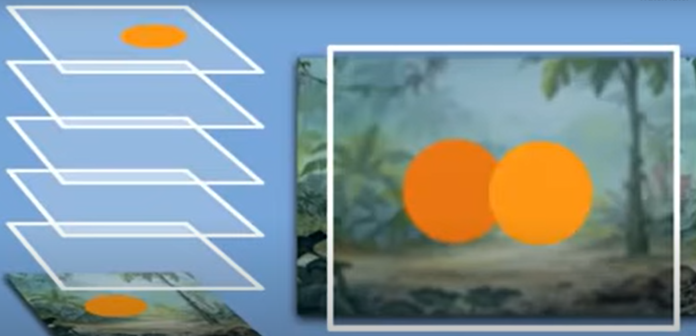

Slide 10
Animation Techniques
Cel Animation
Begins with keyframes (first and last frames of an action)
Tweening – the series of frames drawn in between the first and last
Originally hand drawn and “flipped” through to check the “motion”
Now replaced by computer generated graphics

Slide 11
Computer Animation
Based on the same model as cel animation
Uses layers, keyframes, and tweening techniques
Inks special methods for computing RGB pixel values, providing edge detection and layering so that images can blend or produce transparencies, inversions and effects
Speed of the animation depends on computer;
If it is displayed greater than 1/15 sec, then animation may seem slow and jerky

Slide 12
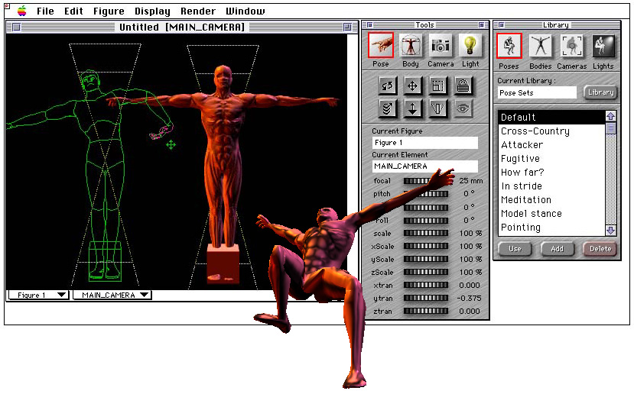
Principles of Animation
Computer Animation
Kinematics is the study of motion of jointed structures

Slide 13
Kinematics
Study of movement and motion of structures that have joints, (such as a person or a walking dog)
Complex- need to calculate position, velocity, rotation and acceleration of all joint and body parts involved
Inverse kinematics – process of linking objects together and define their relationships and limits and then drag the parts and let the computer calculate the result
( for example, connect hands and arms and bent the elbow in various directions)

Slide 14
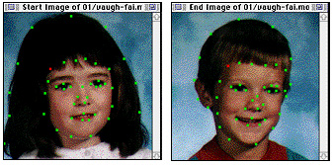
Morphing
is the process of transitioning from one image to another
Process involves connecting a series of key points, which are mapped from the start image to the end image to make a smooth transition

Slide 15
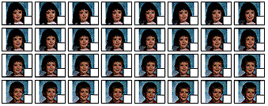
Morphing

Slide 16
Principles of Animation
Animation file formats
Windows Media – .AVI, .ASF, or .WMV
Apple QuickTime – .QT or .MOV
Motion Video – .MPG or .MPEG
Flash – .SWF
Shockwave – .DCR
Animated GIF – .GIF

Slide 17
Animation File Formats
Director (dir) compressed into a Shockwave animation file (dcr) for the web
Windows Audio Video Interleaved Format (avi)
Macintosh ( quicktime, mov)
Motion Video ( mpeg, mpg)
Compuserv ( gif)
Shockwave (dcr)
Compression for Director is 75%+ turning a 100k file into a 25k file

Slide 18
Making Animations that Work
Use animations carefully so your screens don’t become too “busy”
Animation tools
Director
Adobe Animator
GIF animators

Slide 19

Creating Animation
Software helps create objects such as:
A rolling ball

Slide 20
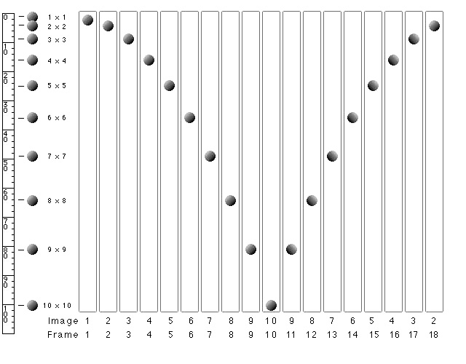
Creating Animation
Software helps create objects such as:
A rolling ball
A bouncing ball
s=1/2gt²

Slide 21
Bouncing Ball
Requires a series of rotations
A knowledge of physics (s= 1/2gt²)
Ball will uniformly accelerate and decelerate by squares 1,4,9,16,….
(as Galileo discovered)

Slide 22
Creating an Animated Scene
A background is chosen
Then an “actor” is video taped running against a blue or green screen
A few frames of the running man are captured by a video capture board and the blue background is removed
Finally, the action is placed on the background…. And King Kong, or Jurassic Park is born

Slide 23
Gif Animation Resources
Animated GIF
https://www.easygifanimator.net/
https://www.gif-animator.com/index.html

Slide 24
Q-A
Example 1: How many key frames does a one-minute animation film sequence with no duplications require ?
Solution: One minute = 60 seconds
No. of frames required per second=24
No. of frames required in entire film=24*60=1440
So, we would need 1440 frames for a one-minute animation film.
Example 2: How many key frames does a one-minute animation film sequence with no duplications require if there are five in betweens for each pair of key frames ?
Solution: One minute = 60 seconds
No. of frames required per second = 24
No. of in-between frames = 5
No. of frames required in entire film=(24*60)/5=288

Slide 25
Why does an animation film require 24 animation frames per second? Can this number be less than 24? If yes, then up to what extent this number can decrease and what will be the effect of animation on the reduction of this number?
Animation is an application based on the principle of persistence of vision that is (1/16)^{th} of a second , so if we have approximately 24 frames change per second then our eye will not be able to identify the discontinuities in the animation scene .
If the number of frames decreases to less than 24 frames per second then possibility of detecting the discontinuities in the scene increases and our animation will not be effective

